Slide 1


Slide 2

DATING APP
BY
TEAM JADAG

Slide 3
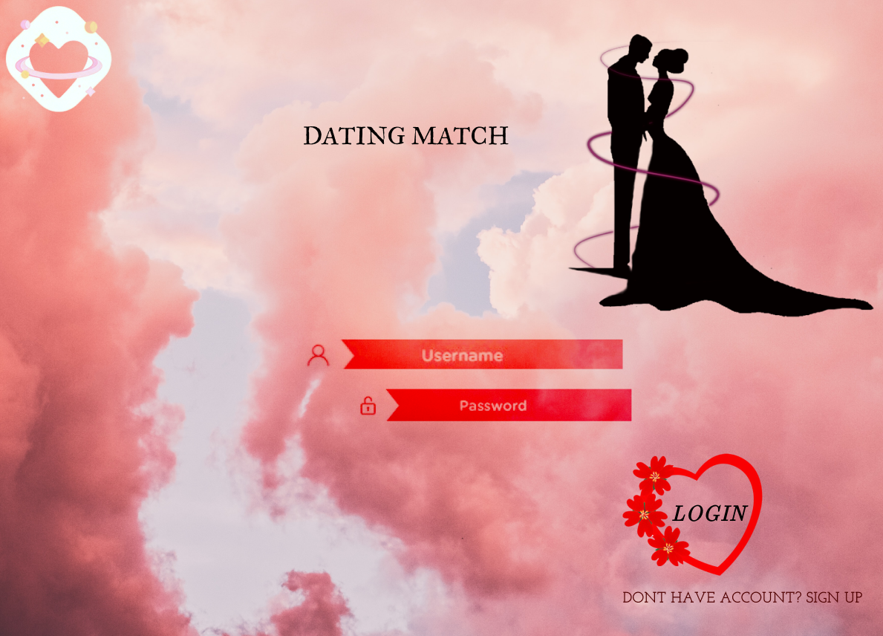
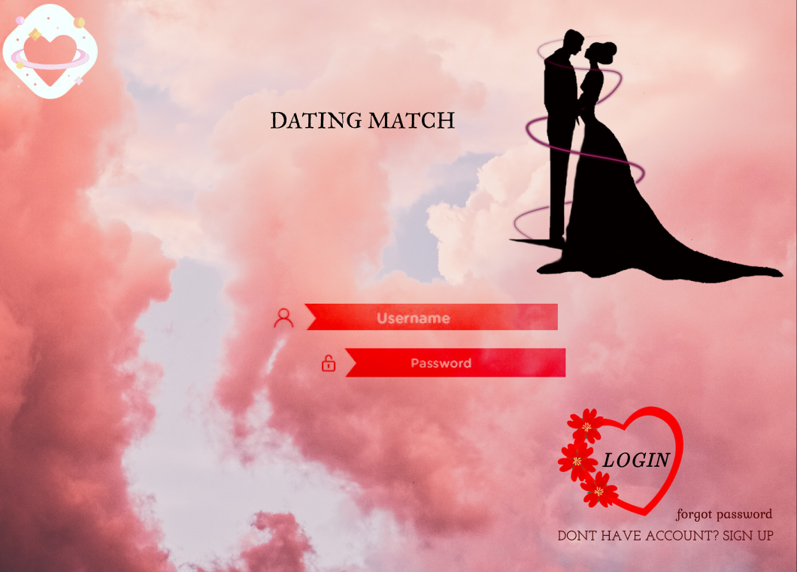

Slide 4
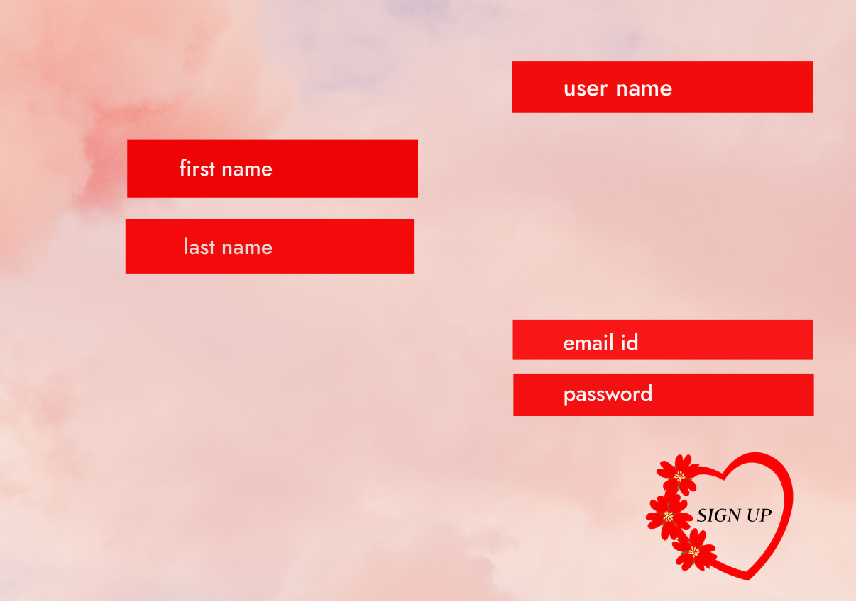

Slide 5
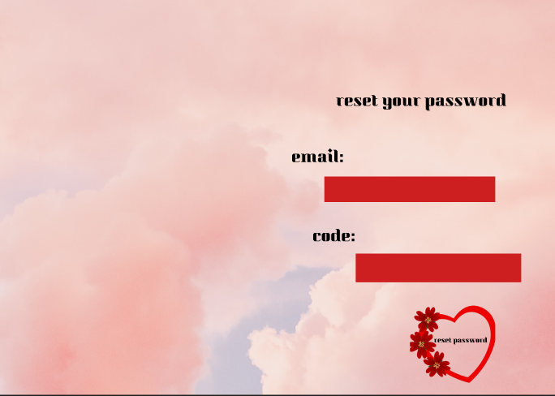

Slide 6
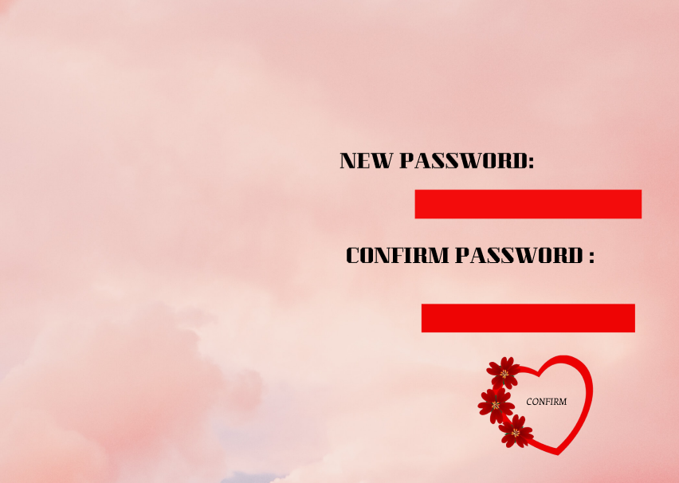

Slide 7
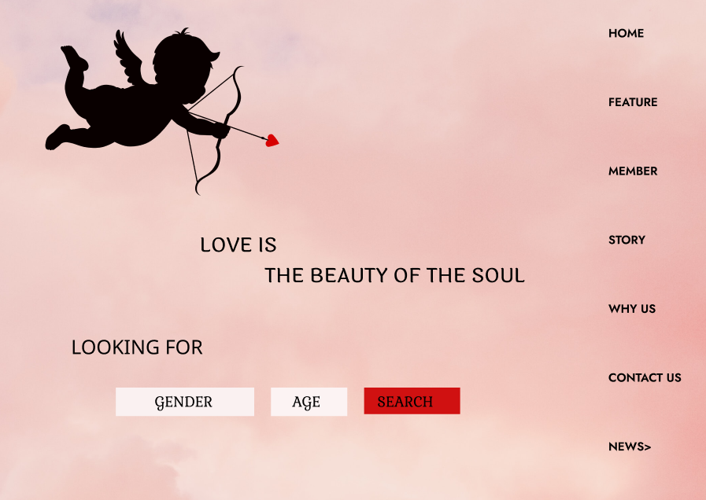
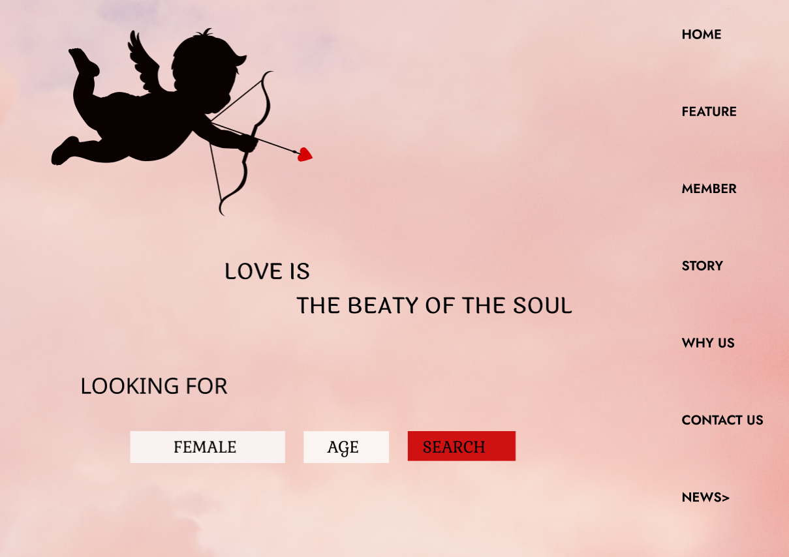

Slide 8
CLICK HERE TO REGISTER !
GITHUB URL : https://github.com/ahamedjaas/DATING-MATCH/upload

Slide 9


